Slide 1


SRM Institute of Science and Technology
(FACULTY OF SCIENCE & HUMANITIES)
DEPARTMENT OF COMPUTER APPLICATIONS
Library Management System
SUBMITTED TO :
Ms. Beena Sachan
(Assistant Professor)
SUBMITTED BY :
Name: - Vishujeet Kumar
Reg: - RA2331342030037

Slide 2


INTRODUCTION
A Library Management System (LMS) is software designed to manage library operations efficiently. It tracks books, borrowers, and transactions such as issuing, returning, and calculating fines.
Purpose:
Automate key library tasks to reduce manual errors.
Simplify borrowing and returning processes with an easy-to-use interface.
Provide accurate tracking of overdue books and fines.
Why It’s Important?
As libraries grow, manual tracking of books becomes unmanageable. An LMS offers automation, making book management fast and reliable.

Slide 3
PROBLEM STATEMENT
Challenges in Traditional Library Management:
Manual Errors: Human errors in tracking book borrowing and returns.
Limited Book Search: Time-consuming to locate specific books manually.
Overdue Books: Lack of automated reminders for overdue returns.
Security Risks: No role-based system to control user access and actions.
How LMS Solves These Problems:
Provides quick search capabilities.
Automates overdue tracking and fine calculation.
Restricts access to functions based on user roles.

Slide 4
OBJECTIVES & SCOPE
Objective:
Develop a system to automate book management, borrowing, and return.
Implement role-based access for students, staff, and lecturers.
Track fines for overdue books automatically.
Scope:
User Roles: Students, staff, and lecturers with different borrowing limits.
Core Features: Book management, borrowing, return tracking, and fine calculation.
Technology Used: Python (with Tkinter) and MySQL for backend and data management.

Slide 5
SYSTEM ARCHITECTURE
Technology Stack:
Backend and Interface: Python with Tkinter.
Database: MySQL to store and manage book, member, and transaction data.
Software Tools: MySQL Workbench, Python IDE for development.
Workflow Diagram:
User logs in through the Tkinter interface.
The system authenticates the user and provides access based on role.
Users search for books, borrow, or return them.
MySQL handles all data storage and updates in real-time.

Slide 6
DATABASE SCHEMA DESIGN
Database Name: library_db
Table Name: library
Explanation:
Key Columns:
This schema ensures efficient data storage and management of books, members, and borrowing details. Relationships between book and member records allow tracking of all transactions.
Member: Identifies the user type (student, staff, lecturer).
Member_PRN_NO: Unique identifier for each member.
BookId, BookTitle, Author: Store book information.
DateBorrow, DateDue, DateOverdue: Tracks borrowing and return status.
FinalPrice: Holds the calculated fine for overdue returns.

Slide 7
CORE FEATURES AND FUNCTIONALITIES
User Authentication and Role Management:
Each user logs in with unique credentials.
System restricts actions based on the role (e.g., students can borrow fewer books than staff).
Book Management:
Add, update, and remove books in the library.
Monitor book availability in real-time.
Borrowing and Return Management:
Borrowing date and due date are tracked automatically.
Return process updates book status in the database.
Search Functionality:
Search books by title, author, or category.
Overdue Fine Calculation:
Automatically computes fines for overdue books based on return dates.

Slide 8
TOOLS
Python (Tkinter):
Used for developing the user interface.
Provides a simple GUI framework for creating interactive windows.
MySQL:
Acts as the backend database to store and manage book, member, and transaction data.
MySQL Workbench used for creating tables and managing queries.
Python IDE (VSCode):
Your paragraph used for writing and debugging Python code efficiently.

Slide 9
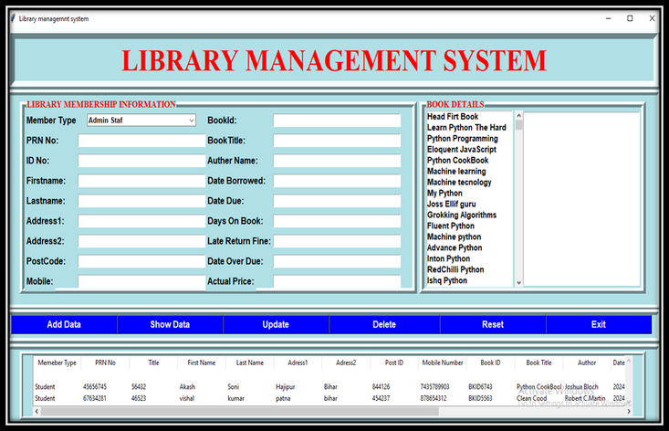
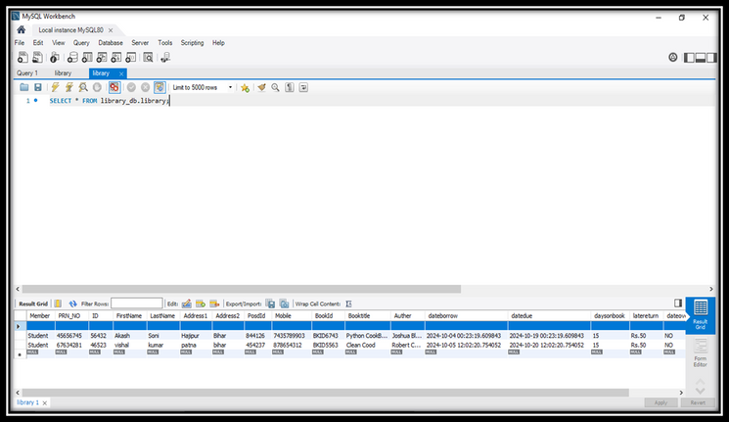
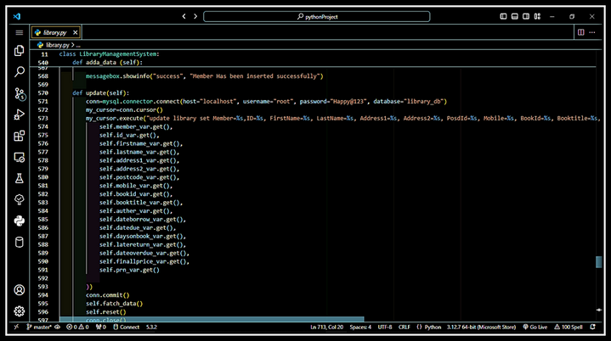
OUTPUT
Frontend
Database
Python IDE (VSCode)

Slide 10
CONCLUSION
Summary:
The Library Management System developed using Python (Tkinter) and MySQL offers efficient management of books, members, and transactions.
The system ensures smooth book borrowing and return processes with accurate overdue tracking and fine calculation.

Slide 11

Thank You

